Slide 1
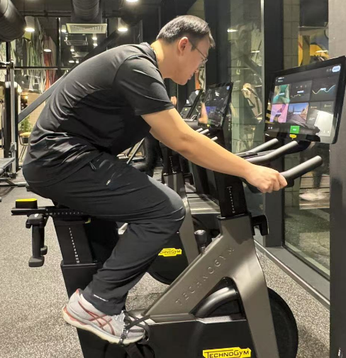

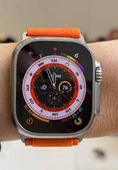
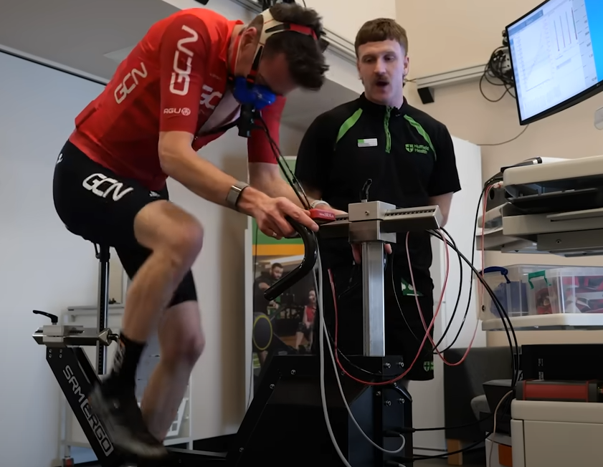
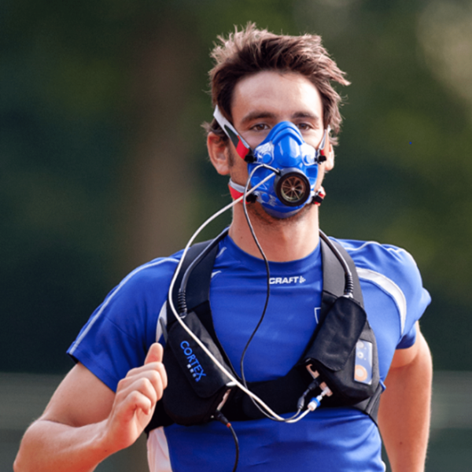
My Vélo Mate
Real-Time Cycling Monitor: Providing Professional Data Support for Enthusiasts
VO2max
Heart rate
Power
£200
€8000

Slide 2
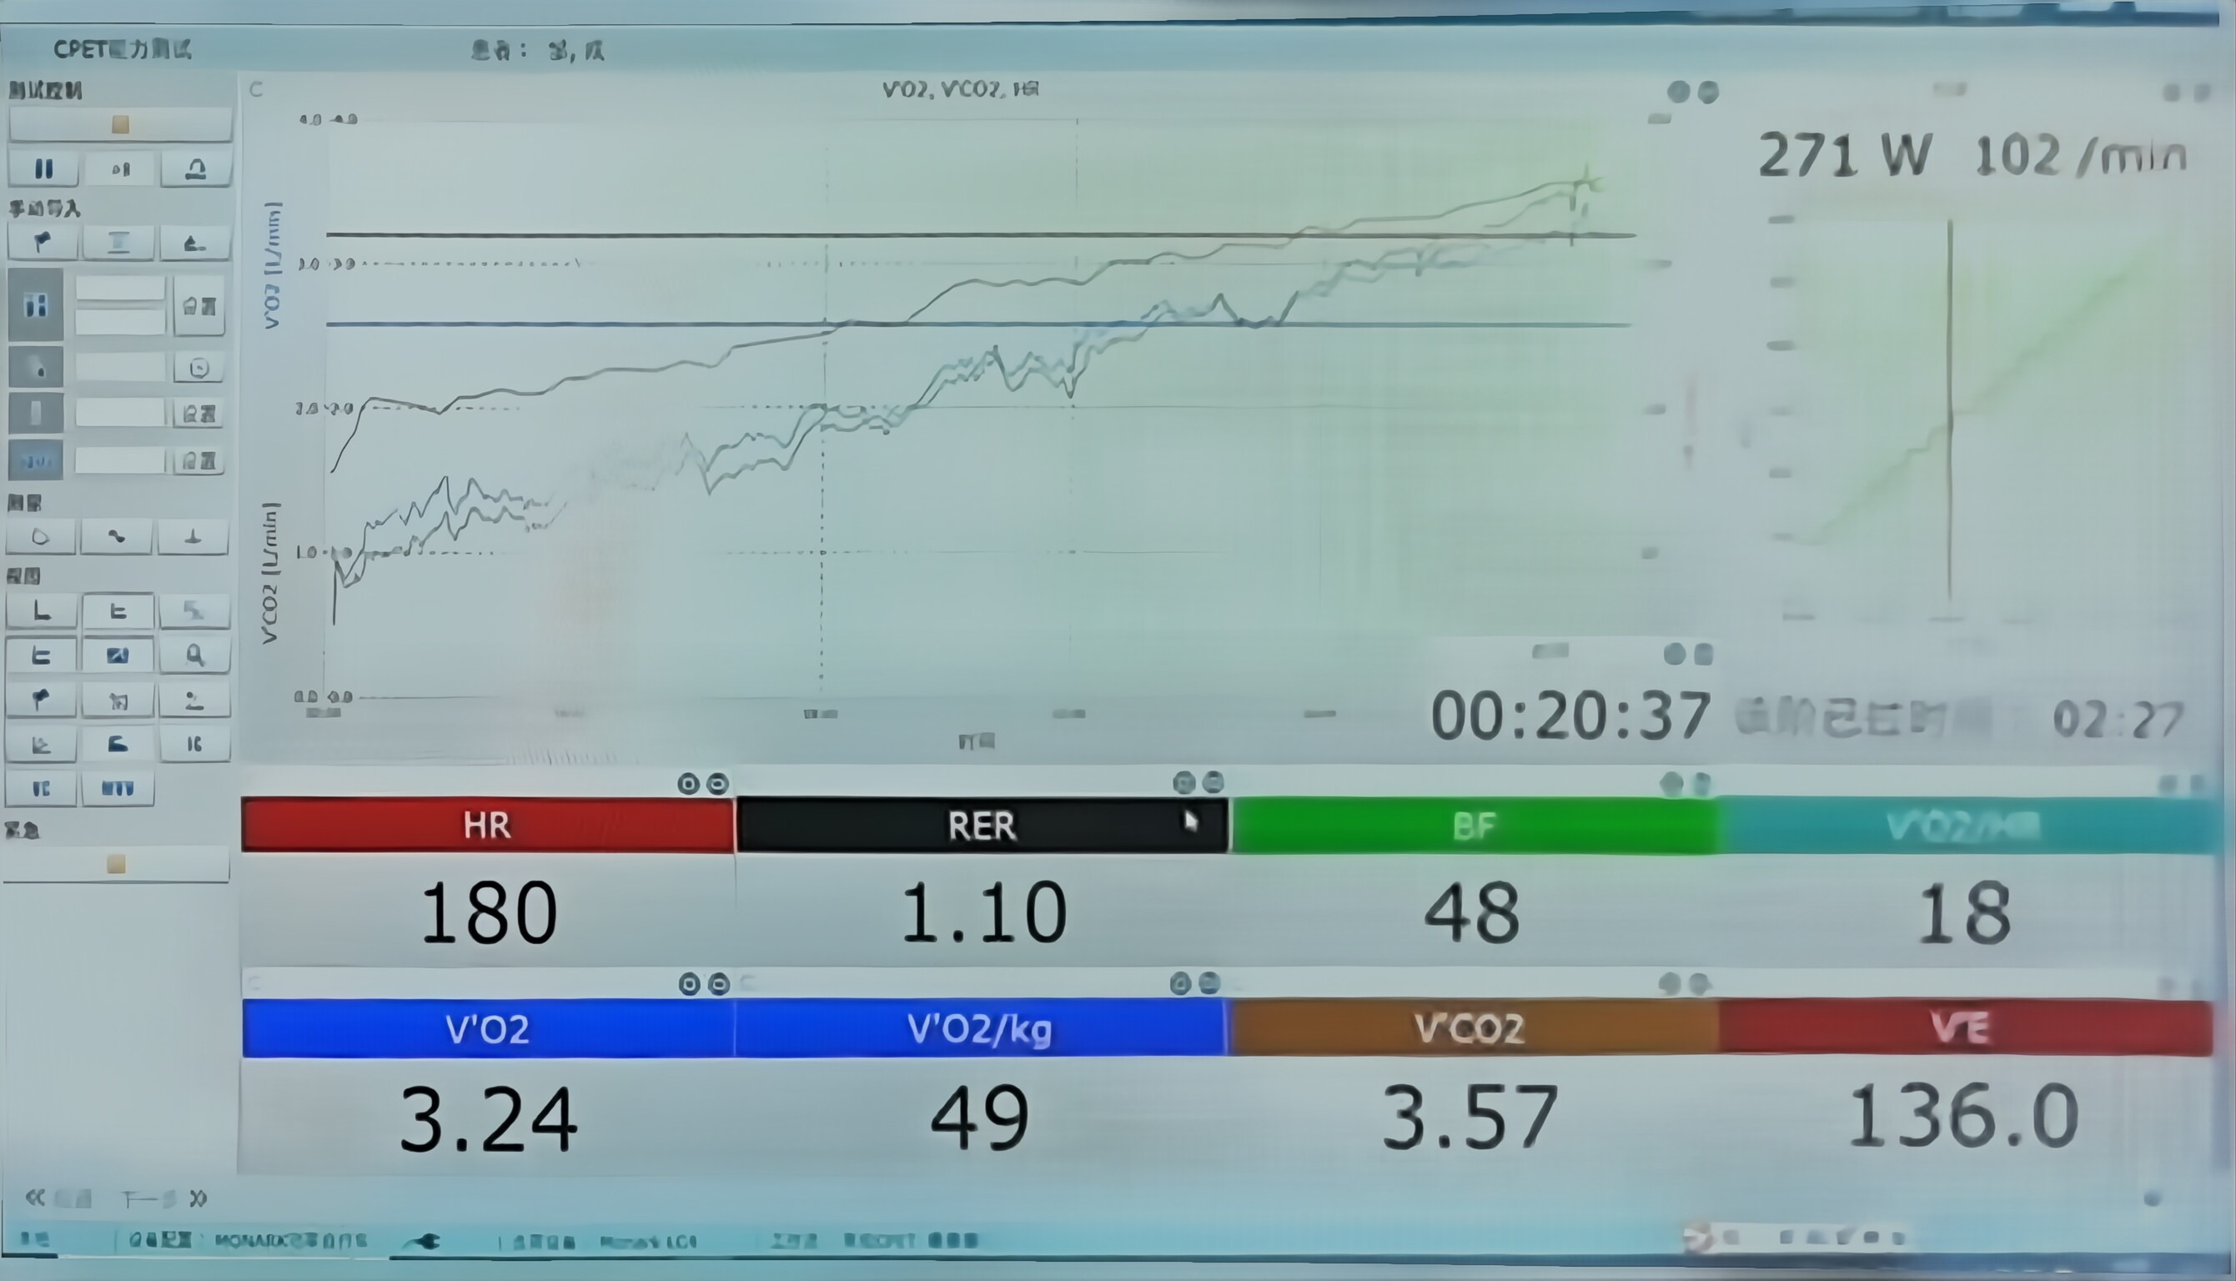
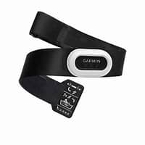
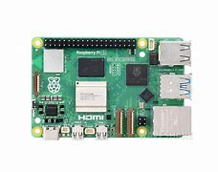
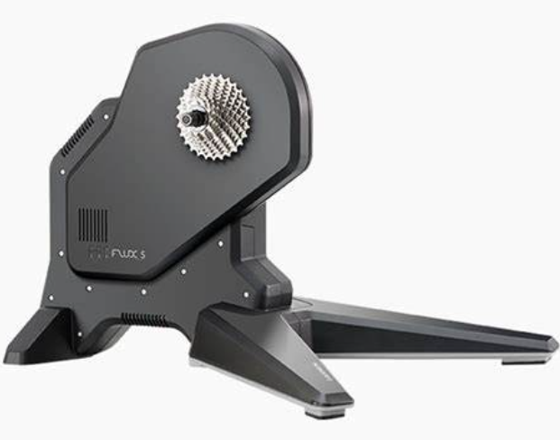


Ride Smarter, Train Harder, Without Breaking the Bank
Heart Rate Belt
Wattbike
HDMI
O2 Sensor
Ver 1.0: Basic heart rate, power, and VO2max detection
Ver 2.0: Real-time multithreaded data processing and display
Ver 3.0: Training recommendations based on user performance levels
I2C

